Slide 1
Bathtubs, Slinkies, and Mirrors
Using common experiences
to visualize wave physics in antenna feed line systems
Clallam County Amateur Radio Club Bill Peterson – K7WWP October 10 , 2018

Slide 2
New ideas that you already know
It’s easier to learn and understand something when the new idea fits into your vision of reality like a piece into a jigsaw puzzle.
It’s just an extension of what you already know.
Once you know how it fits, it’s easier to understand and remember.
My goal is to make wave physics on antenna feed systems easier to understand.
Notes:
This is how high-school and most college classes were for me.
Until I got halfway through my junior year, then suddenly things were hard as I was getting into the realm of things that weren’t intuitive.
Tonight, I hope we can explore some intuitive commonly observable phenomena that helps us understand antenna transmission line systems.

Slide 3
A wave travels in some medium
A sound wave in the air
A wave in water
A wave down a string
A wave of light
A wave of electricity down a wire

Slide 4
And Then the wave Hits Something
A sound wave in the air
The end of the air (the canyon wall)
A wave in water
The end of the bathtub
A wave down a spring
The end of the spring
A wave of light in the air
A window or mirror (The end of the air)
A wave of electricity down a wire
The end of the wire

Slide 5
A sound wave
Echo
Echo
Echo
Echo
Echo
Echo
Echo

Slide 6
Spring Demo

Slide 7
Spring Demo
Notes:
See the Wave.
See the Wave reflected back.
-- Ask for volunteer to hold end of spring.
-- See the wave reflected back even if the end is secured.

Slide 8
A ray (Wave) of Light hitting a mirror

Slide 9
The end of the wire
We can’t see anything
But in all other cases, the wave bounced back
Won’t that also happen with electricity at the end of the wire?
Power spikes
Clicks you hear on the radio when you flip a light switch
Power spikes that cause sever overvoltage and destroy electronics
The inductive nature of power loads makes this problem far worse
Surge protectors
Notes:
Power spikes are also caused by abrupt changes in voltage over reactive loads.

Slide 10
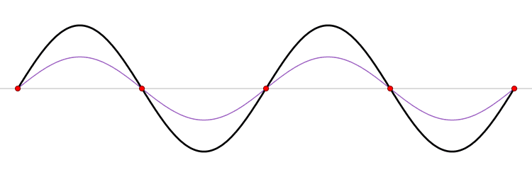
Standing Waves
Waves move in one direction
Waves reflect back
The combined effect is standing waves

Slide 11
Standing waves off the side a bridge

Slide 12
Standing Waves and resonance
When the reflected wave is reflected back
And it matches and reinforces the original wave
Then it builds up, finally limited by the resistance in the system.

Slide 13
Demo Standing Waves ON SPRING

Slide 14
Examples of Resonant waves
Vibrating stings on a musical instrument such as a guitar, piano, violin
Column of air in flute or trumpet
Light in a laser
Radio waves in a microwave oven

Slide 15
Will Standing Waves hurt my Radio?

Slide 16
Will Standing Waves hurt my Radio?
Let’s look at what standing waves will do to a bridge

Slide 19
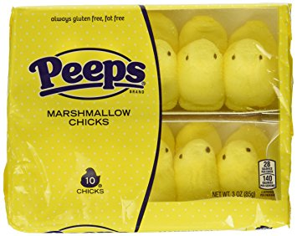
Standing waves in a microwave
Microwave and peeps.
2.45 G
300 / 2450 = .1225 meters
½ wavelength = .061 meters
½ wavelength = 2.4 inches
The rotating plate moves the food so the standing don’t heat just parts of the food.

Slide 20
Partially melt peeps in microwave without the rotating plate.

Slide 21
Open/Short
Spring Demo

Slide 22
Back to the Spring
Reflections with free end
Momentum
Reflections with secured end
Energy

Slide 23
Mismatches cause reflection
Shorts cause reflection in one direction
Opens cause reflections in the other direction
As you move between a short and an open
The reflection will get smaller, minimize, and get larger in the opposite direction
At the minimized point, you have the best match.
Discontinuities in the feed line
Kinks
Wrong connectors
Bad connection

Slide 24
Mismatch high impedance to Low Impedance

Slide 25
Mismatch Low impedance to High impedance

Slide 26
Partial reflections

Slide 27
Partial reflection of waves of light

Slide 28
Somewhere in the middle
Between the wave that is reflected positively
And the wave that is reflected negatively
Is a point where no wave is reflected at all. This is a matched junction.
Reflected waves travel more than once on the feed line.

Slide 29
Match / Mismatch demo

Slide 30
Transmission Line Losses
Refection Points
Mismatched Feedline / Antenna
Mismatched sections of Feedline
Kinks and feed-line damage
Mismatches because connector is not rated for higher Frequency
Ex. 239 connectors on UHF

Slide 31
Finally we talk about antennas

Slide 32
Antenna Tuner in Shack

Slide 33
Antenna Tuner at Antenna Feed Point

Slide 34
Ladder Line is great

Slide 35
Line Losses on 100 feet of feed line
Feed Line | Freq | SWR 1:1 | Loss | SWR 3:1 | Loss | SWR 10:1 | Loss
RG-58 Coax | 10 MHz | 1.12 dB | 23 % | 1.66 dB | 32 % | 3.71 dB | 67%
RG-213 Coax | 10 MHz | 0.62 dB | 13% | 0.97 dB | 20% | 2.40 db | 42%
450 ohm Ladder | 10 MHz | 0.21 dB | 5 % | 0.33 dB | 7.4% | 0.93 dB | 19%

Slide 36
Open / Short Revisited
Short reflect in opposite direction
Opens reflect in same direction
Short (Fixed end) spring stretches out, and is then pulled back, but because the end is fixed, the pull back is against the wave. The reflection is reversed.
Voltage is zero
Current flows
Open spring swings, then swings back. Reflection is same.
Voltage swings freely
Current is zero

Slide 37
Quarter Waves
Open on one end appears Closed (Shorted) on the other
Notes:
Only half of you have their eyes glazed over. Let’ see if I can get the rest of you.

Slide 38
Quarter Wave Stub

Slide 39
Quarter Wave Stub Filter
At a specific frequency:
Open quarter wave stub will appear as a short.
Can be used to short out harmonics. Use open quarter wave stub at harmonic frequency.
My transmitter at 40 meters with second harmonics (20 meters)
Open quarter 20 meter stub will short out my 2nd harmonics.

Slide 40
Quarter Wave Transformers

Slide 41
Quarter Wave Transformers

Slide 42
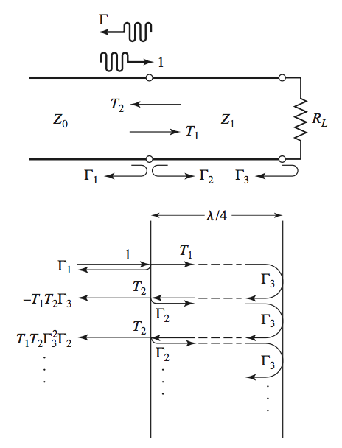
An infinite number of reflections and re-reflections sum up
No reflections
No power loss
Load appears as Z₀

Slide 43
Z_{T}
Z_{L}
Z₀
If Z of the load is high,
the other end of a quarter wave section makes it look low. Z_{T} combined with the inverted Z_{L} = Z₀
Z_{T}
Z₀
+Z_{L} inverted
Looks like Z₀

Slide 44
Quarter wave transformers on PC Boards

Slide 45
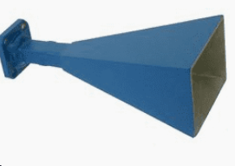
Microwave - Stepped Guide - Variable guide (Microwave horn)

Slide 46
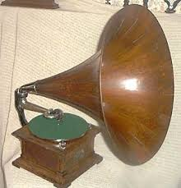
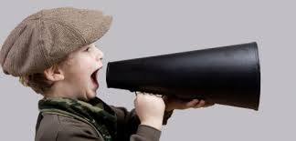
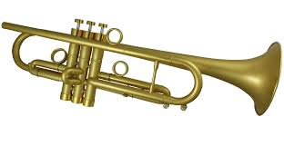
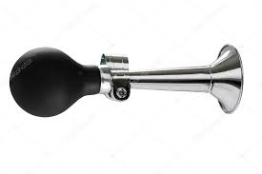
These are all forms of matching from sound generator to the open air

Slide 47
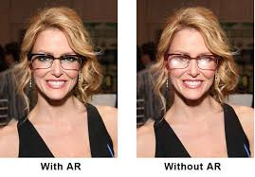
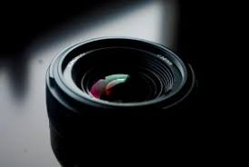
Quarter Wave anti-reflective coating

Slide 48
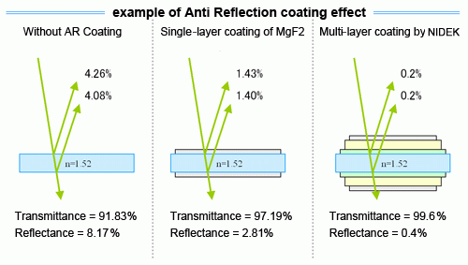

Slide 49
In Summary, waves are waves

